Slide 1

CHINOOK Music Store Analysis
by Arnav Bangaria

Slide 2
PROBLEM STATEMENT
The company wants to enter the Physical Music Market, analyse music record sales to derive insights, and develop a Go-To-Market (GTM) Strategy

Slide 3
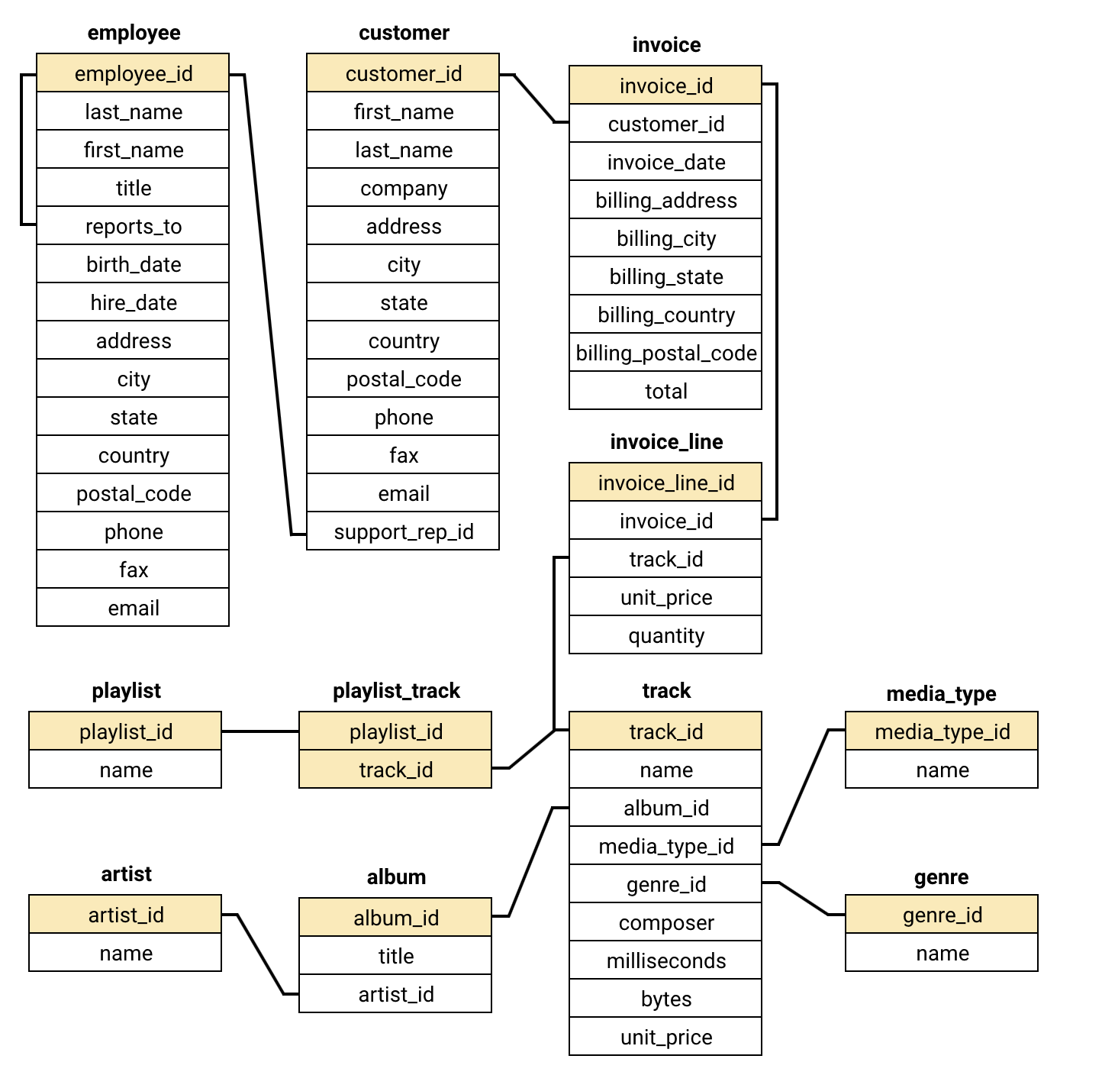
DATA OVERVIEW
There are a total of 11 tables in the dataset, which are as follows:
employee
customer
invoice
invoice_line
track
media_type
genre
album
artist
playlist
playlist_track

Slide 4
DATA OVERVIEW
S.No | Table Name | No. of Attributes | Categorical / Continuous Count
1 | album | 3 | 2 categorical and 1 continuous
2 | artist | 2 | 1 categorical and 1 continuous
3 | customer | 13 | 10 categorical and 3 continuous
4 | employee | 15 | 11 categorical and 4 continuous
5 | genre | 2 | 1 categorical and 1 continuous
6 | invoice | 9 | 6 categorical and 3 continuous
7 | invoice_line | 5 | 2 categorical and 3 continuous
8 | media_type | 2 | 1 categorical and 1 continuous
9 | playlist | 2 | 1 categorical and 1 continuous
10 | playlist_track | 2 | 2 categorical and 0 continuous
11 | track | 9 | 5 categorical and 4 continuous

Slide 5
METHODOLOGY
DATA CLEANING AND STRUCTURING
Loading data using the SQL query given and checking whether relationships are established between the tables or not (in this case, it was missing)
Establishing relationships between various tables as per the Entity Relationship Diagram (ERD) using ALTER and GUI methods in MySQL Workbench
DATA MANIPULATION
Removing inconsistencies and duplicates from the data table by table to maintain consistency
DATA ANALYSIS
Analysing geographical track sales data to find emerging markets and performance of albums, artists, and genres in these markets
Analysing customer demographic data to understand and develop customer segmentation, combined with purchase data to understand the requirements of the customer
Doing performance analysis on tracks, albums, genres, and artists to suggest assets that can be used in promotional campaigns
VISUALIZATIONS
Developing visualizations based on findings to communicate better with stakeholders

Slide 6
ANALYSIS PHASE

Slide 7
Geographical Analysis
Five countries (USA, Canada, Brazil, France, and Germany) account for 50% of the customers from a total of 59 customers

Slide 8
Geographical Analysis
Due to the presence of more customers in the country same 5 countries hold more than 50% of the revenue generated out of the total revenue of 4709.03

Slide 9

Geographical Analysis
Country | Average Total Amount Spent per Cust | Average Count of Tracks Purchase per Cust
Czech Republic | 136.62 | 138
Ireland | 114.84 | 116
Spain | 98.01 | 99
Chile | 97.02 | 98
Portugal | 92.57 | 94
India | 91.58 | 93
But when it comes to Average Total Revenue per Customer and Average Count of tracks per Customer, then 6 countries (Czech Republic, Ireland, Spain, Chile, Portugal, and India) lead the way

Slide 10
Geographical Analysis
After comparing sales data of this year and the previous year, we can find that amongst the Top countries by Sale, countries like Canada, Germany, France, USA have a shrinking market, while only 4 countries (Czech Republic, Ireland, Brazil, and India) have a growing market

Slide 11
Geographical Analysis
In emerging countries, Prague, Mountain View, London, and Berlin, etc., these are the cities that have the highest sales and have a growing demand they can serve as our entry point in physical music market

Slide 12
Customer Analysis
Customer Type | % of Customers | Avg Total Purchase Made | Purchasing Frequency in Days | Total Spends | Basket Size
Long-Term | 80 | 11 | 127 | 3946 | 8
New | 20 | 9 | 115 | 763 | 7
Out of total 59 customer 80% are Long-Term (purchasing >3 years) customers and 20% are New customers. Long-Term customers have a bigger basket size but longer purchasing frequency. New Customer have a smaller basket size but shorter purchasing frequency

Slide 13
Customer Analysis
About 85% of customers have a purchasing frequency of less than 6 months. Out of 59 customers, 27 buy Quarterly, and 20 buy every 5 months.

Slide 14
Customer Analysis
About 46% customers have a lifetime value between 75-100 and about 36% customers have a lifetime value between 50-75 which cumulatively hold 82% customer in range 50-100

Slide 15
Customer Analysis
Risky customers are those who have stopped purchasing in between and then started purchasing again and have a high chance of churn. About 29% customers out of the total customers are risky customers. And about 25% of these are confined in range 50-100 lifetime value range.

Slide 16
Customer Analysis
About 27% of customers have not purchased in 6 months or 180 days (while there are only 3% customers in the range above 180 days purchase frequency), which means they have high chances of churning. About 26% of these customers lie in the range 50-100

Slide 17
Track Analysis
Rock genre is the most purchased genre, leading by far, and then followed by Metal and Alternative & Punk. The drama genre is the least purchased genre. Rock genre alone holds approximately 50% of Total Revenue.

Slide 18
Track Analysis
Amongst all customers top buys Album “Are You Experienced?” and the Artist Jimi Hendrix are the most bought side. About 119 tracks were purchased from the album “Are You Experienced?” whose artist is none other than Jimi Hendrix.

Slide 19
FINDING PHASE

Slide 20





Strategic Questions
Which markets are growing and can be utilized for growth?
What can be the entry point in these growing markets?
Who are our adopters and customers in these regions?
What opportunities and challenges exist for our customers?
How to optimize our reach and capture the market?

Slide 21
Strategic Suggestions
Which markets are growing and can be utilized for growth?
There are 4 major countries with growing markets, which are the Czech Republic, Ireland, Brazil, and India
What can be the entry point in these growing markets?
The following cities act as entry points in the market: Prague(Czech Republic), Dublin(Ireland), Brazil, São Paulo (Brazil), and Delhi(India)
Who are our adopters and customers in these regions?
Our major customers are people whose lifetime value lies between 50-100. They like to purchase tracks in the Rock genre quarterly or every five months
What opportunities and challenges exist for our customers?
Our customers love Rock, Metal and Alternative & Punk genres. They are segregated into Long-Term and New customers based on lifetime span, and some customers are risky and can churn
How to optimize our reach and capture the market?
Customers are extremely inclined towards Jimi Hendrix and his album “Are You Experienced?” which can be used as the face of our promotional campaigns to get the attention of our customers

Slide 22
CONCLUSION

Slide 23
We should first enter Prague (in the Czech Republic), which is the fastest-growing market
Initially targeting customers with a lifetime value in the range of 50-100
Offering them the Rock and Metal genre
Capturing their attention using promotional campaigns that display artist Jimi Hendrix and his album “Are You Experienced?”
Addressing risky customers as follows: if customers are new, then providing them discounts and offers, whereas for Long-term customers, we can develop a loyalty-based system
Finally, these promotional campaigns should be synchronized with customers’ purchasing frequency, which is quarterly or every five months, increasing the rate of success of campaigns

Slide 24
THANK YOU

